Slide 1
CS 575
Design and Analysis of
Computer Algorithms
Professor Michal Cutler
Network flows

Slide 2
This class
Network flow definitions
Ford and Fulkerson

Slide 3
Maximum flow and minimum cut
Cornerstone problem in combinatorial optimization
Many applications: Network connectivity, bipartite matching, project selection, network reliability, data mining, image processing, job scheduling for real time applications, baseball elimination, etc.

Slide 4
A flow network
v₁
5
10
v₃
t
7
15
12
s
v₂
6
A directed graph G=(V, E) in which each edge (u, v) ∈E has a nonnegative capacity c(u, v) ≥ 0.
If (u, v) ∉E , c(u, v) = 0
Contains a source node s, and a sink node t
Every node u ∈V is on a directed path from s to t.

Slide 5
Networks
Networks | Nodes | Arcs | Flow
communication | Telephone exchanges, computers, satellites | Cables, fiber optics, microwave relays | Voice, video, packets
financial | Stocks, currency | Transactions | money
transportation | Street intersections, airports | Highways, airway routes | Freight. vehicles, people

Slide 6
Flow
An s-t flow is a function f: V×V -> R that satisfies:
  Capacity Constraint: (the flow cannot exceed the capacity)
      for all u, v, f(u, v) ≤ c(u, v)
  Skew symmetry: (if f is flowing from u to v, –f is flowing from v to u)
  for all u, v, f(u, v) = -f(v, u)
11,15

Slide 7
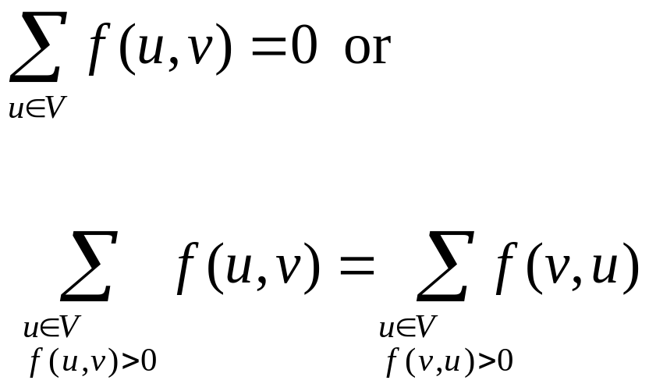
Flow
Flow conservation:
  sum of flows from a node is 0, or
  the sum of the flows that leave a node is equal to the sum of the flows that enter it
  for all u ∈V –{s, t}

Slide 8
Flow conservation example
v₁
5, 5
v₃
v₄
11,15
6,12
v₂
f(v₃, v₁) +f(v₃, v₂)+f(v₃, v₄)=0
f(v₃, v₁)= -f(v₁, v₃)= -5
f(v₃, v₂)= -f(v₂, v₃)= -6
-5 - 6 + 11= 0
Flow entering v₃ =f(v₁, v₃) + f(v2, v₃)= 5+6 =11,
Flow leaving v₃ = f(v₃, v₄) = 11

Slide 9
An example of a flow
v₁
5, 5
5,10
v₃
t
0, 7
11,15
6,12
s
v₂
6, 6
The capacity constraints and skewed symmetry are satisfied for all edges
Conservation is satisfied.

Slide 10
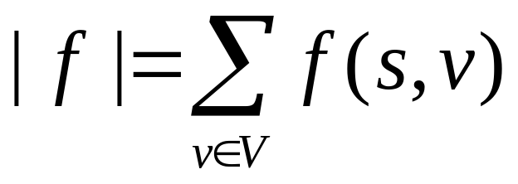
Max flow problem
v₁
5, 5
9,11
v₃
t
4, 7
15,15
10,12
s
v₂
6, 6
Find s-t flow f* that maximizes net flow out of the source
The current value of the flow:
For our example |f| = f(s, v₁) + f(s, v₂) = 9 +6 = 15 is a max flow

Slide 11
What if there is more than one source? Or sink?
s₁
t₁
∞
∞
s
∞
s₂
S
t
∞
t₂
∞
s₃
Add a super source s and a super sink t, and an edge from s to each source and from each sink to t. The capacity of these edges is ∞

Slide 12
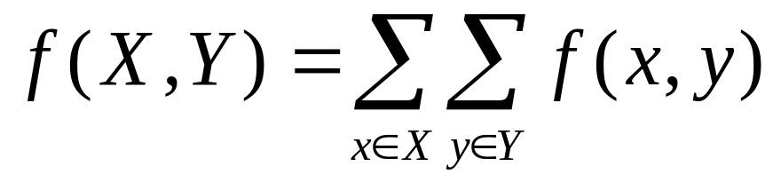
Working with flows
If X and Y are sets of vertices
L1
For all X⊆V, f(X, X) = 0
For all X, Y⊆V, f(X, Y) = -f(Y, X)
For all X, Y, Z ⊆V, with X ∩ Y = ∅,
f(X ∪ Y, Z)=f(X, Z)+f(Y, Z) and
f(Z, X ∪ Y)= f(Z, X) + f(Z, Y)

Slide 13
Working with flows
v₁
5, 5
5,10
v₃
t
0, 7
11,15
6,12
s
v₂
6, 6
Let X={s, v₁} Y={v₂, v₃}, Z={t}
f(X, X)=f(s, v₁)+f(v₁, s)=5–5= 0
f(X, Y)= f(s, v₂) +f(v₁, v₂)+f(v₁, v₃) = 11, f(Y, X) = -11
f(X∪Y, Z)=f(v₃, t) = 11,
f(X, Z)=0 and f(Y,Z)=f(v₃, t) =11

Slide 14
|f| = total flow out of source = total flow into the sink
|f| = f(s,V) (By def.)
= f(V,V) - f(V - s, V) (L.1-3)
= - f(V - s, V) (L.1-1)
= f(V, V - s) (L.1-2)
= f(V, t) + f(V, V - s - t) (L.1-3)
= f(V, t) (flow conservation)
For next slide U is the maximum capacity, V the number of nodes and E the number of edges in the network.

Slide 15
Some History
Year | Researcher | Method | Big-Oh
1955 | Ford & Fulkerson | Augmenting path | EVU, or (E+V)f*
1970 | Edmonds-Karp | Shortest path | E²V
1974 | Karzanov | Preflow-push | V³
1986 | Goldberg-Tarjan | Preflow-push | EVlg(V²/E)
1997 | Goldberg-Rao | Length function | E^{3/2} * lg(V²/E)U

Slide 16
The Ford and Fulkerson method
Initialize flow f of all edges to 0
while there exists an augmenting path p in residual network
augment flow f along p
return f
Need to explain what are augmenting paths (and residual networks)

Slide 17
Residual Networks
The amount of additional flow we can push from node u to v before exceeding the capacity c(u, v) is the residual capacity of (u, v)
c_{f}(u, v) = c(u, v) –f(u, v)
Examples
c(u, v)=16 and f(u, v)=11-> c_{f}(u, v) =5
c(u, v)=16 and f(u, v)=-4 -> c_{f}(u, v) =20

Slide 18
Residual networks
Given a flow network G=(V, E) and a flow f, the residual network of G induced by f is G_{f} = (V, E_{f}) where
E_{f} = {(u, v)∈V×V| c_{f}(u, v) > 0}
The edges in E_{f} are either edges in E or their reversals

Slide 19
Residual networks – how many edges?
If f(u, v) < c(u, v) for (u, v) ∈E ->
c_{f}(u, v) > 0 and (u, v) ∈ E_{f}
If f(u, v)<0, for (v, u) ∈E, and f(v, u)>0 -> c_{f}(u, v) > 0 and (u, v) ∈ E_{f}
If neither (u, v) ∈E or (v, u) ∈E then c(u, v)=c(v, u)=0, f(u, v)=f(v, u)=0, and c_{f}(u, v)=c_{f}(v, u)=0 ((u, v) ∉ E_{f})
So |E_{f}| ≤ 2|E|

Slide 20
The residual network
v₁
5, 5
G
5,11
v₃
t
0, 7
11,15
6,12
s
v₂
6, 6
v₁
5
G_{f}
11
5
6
v₃
t
7
4
6
s
v₂
6
6

Slide 21
Lemma L.2
Given a flow network G with flow f, and a residual network induced by f with flow f’. There is a flow in G with value |f + f’|=|f| + |f’|
Proof outline:
Verify that skew symmetry, capacity constraint and flow conservation are obeyed, and the total flow from s is |f| + |f’|

Slide 22
Augmenting paths
An augmenting path p is a path from s to t in the residual network G_{f}.
The maximum amount by which we can increase the flow on an augmenting path p is the residual capacity of p,
c_{f}(p) = min{c_{f}(u, v)| (u, v) is on p}

Slide 23
An augmenting path
c_{f}(p) = min{c_{f}(u, v)| (u, v) is on p} = min{6, 7, 6, 4}=4
Adding 4 to the edges in G results in the maximum flow (for this example)
v₁
5
G_{f}
11
5
6
v₃
t
7
4
6
s
v₂
6
6

Slide 24
The updated flow
v₁
5, 5
9,11
v₃
t
4, 7
15,15
10,12
s
v₂
6, 6

Slide 25
Cuts
A cut (S,T), is a partition of V into S and T=V-S, such that s∈S, and t ∈ T
The net flow across a cut (S, T) is f(S, T)
The capacity of the cut (S, T) is c(S,T)
Only the capacity of edges from S to T are included in c(S, T) .

Slide 26
Examples of Cuts
T
S
v₃
v₁
6, 6
5, 5
11, 13
1, 6
v₄
t
5, 5
17, 20
12, 12
s
v₂
6, 6
c(S, T) = 6 + 12=18 and
f(S, T) = 6 + 12 – 1= 17 = f ≤ c(S,T).
Only the capacity of edges from S to T are included in c(S, T) .

Slide 27
Examples of Cuts
v₁
v₃
6, 6
5, 5
11, 13
1, 6
v₄
t
5, 5
17, 20
12, 12
s
v₂
6, 6
f(S, T) = c(S, T) = f = 5+ 12=17

Slide 28
Demos
Relevant Algorithm Animations/Visualizations (in Java)
http://www.hig.no/~algmet/animate.html
http://www-b2.is.tokushima-u.ac.jp/~ikeda/suuri/maxflow/Maxflow.shtml
(Alt-tab)

Slide 29
Max-Flow Min-Cut Theorem
The following are equivalent statements:
f is a maximum flow
The residual network contains no augmenting paths.
|f| = c(S,T) for some cut (S,T) of G

Slide 30
Proof (1-->2)
Given: f is a max-flow
Prove: No augenting path in residual net
Proof by contradiction. Suppose there is an augmenting path p.
Then the total flow after we add this path in is |f + f_{p|} > |f|, and that contradicts the assumption that we had a maximum flow.
Conclusion: No augmenting paths

Slide 31
Proof (2-->3)
Given: no augmenting path.
Prove: |f| = c(S,T) for some cut (S,T) of G
  Let S = set of vertices v with a path from s to v in the residual network G_{f}, and T = remaining vertices
This gives a cut of the network, and we know that t is not in S (there is no augmenting path).
For each edge (u, v) from S to T in G, c_{f}(u, v)=0 in G_{f}. So f(u,v) = c(u,v) in G and f(S,T) = c(S,T)
By L.5 |f| = f(S,T) = c(S,T)

Slide 32
Proof (3-->1)
Given: |f| = f(S,T) = c(S,T)
Prove: f is a maximum flow
By C.6, |f| ≤ c(S,T) for all cuts of (S, T). If there exists a cut such that |f| = c(S,T), f cannot possibly be higher.
So f is a maximum flow.

Slide 33
Time Complexity of FF
O(V+E) to find an augmenting path in G_{f} using breadth or depth first search
At most |f*| augmenting paths since each increments flow by at least 1
f*≤ VU, since s is connected to at most V vertices and the capacity of all edges (s, v) is at most U.
So O(E|f*|) = O(EVU) where U is the maximum capacity

Slide 34
Example where FF may be very slow
After 2 augmenting paths the total flow is 2.
1, 10000
1, 10000
10000
1, 10000
1, 1
0, 1
10000
1, 10000
1, 10000
1, 10000

Slide 35
Edmonds-Karp Algorithm
Use BFS to get a shortest augmenting path.
Note: shortest in the number of edges on a directed path from s to t
Complexity is O(V E²)

Slide 36
Maximum Bipartite Matching
Given an undirected graph G = (V, E)
A matching is a subset of edges M ⊆ E such that for all v ∈ V, at most one edge of M is incident on v.
A maximum matching is a matching of maximum cardinality

Slide 37
Maximum Bipartite Matching (cont.)
Assume that G is bipartite
  The vertex set V = L ∪ R
  L and R are disjoint
  All undirected edges in E are between L and R
Assume further that every vertex in V has at least one incident edge.

Slide 38
The Network for Maximum Bipartite Matching
The flow network G’ = (V’, E’) for the bipartite graph is:
  V’ = V ∪ {s,t} where the source s and sink t are new vertices and
  E’ = {(s,u) | u ∈ L} ∪
    {(u,v) | u ∈ L, v ∈ R and (u,v) ∈ E} ∪
    {(v,t) | v ∈ R}
  c(e) = 1 for each e ∈ E’

Slide 39
The Network (continued)
|E’| = |L| + |R| + |E| = |V| + |E|
Since |E| ≥ |V/2|, |E’| ≤ 3|E|
Since f*=|M| ≤ min{|L|, |R|} = O(V) Ford and Fulkerson finds a maximum flow in G’ in O(VE’) = O(VE)

Slide 40
Lemma 26.10
G = (V,E) is a bipartite graph with V = L ∪ R.
G’ = (V’, E’) is a corresponding flow network.
  If M is a matching in G, there is an integer-valued flow f in G’ with value |f| = |M|.
  If f is an integer valued flow in G’, there is a matching M in G, with |M| = |f|

Slide 41
Proof of a)
Given a matching M. The flow corresponding to M:
  For every (u,v) ∈ M, f(s,u) = f(u,v) = f(v,t) = 1 and f(u,s) = f(v,u) = f(t,v) = -1
  f(u,v) = 0 for all other edges (u,v) ∈ E’
It is easy to see that f is a flow (satisfies, skew symmetry, capacity constraint and flow conservation)
The net flow across the cut (L ∪ {s}, R ∪ {t}) is equal to |f| = |M|

Slide 42
Figure for proof of a) of Lemma 26.10
1
1
1,1
5
1,1
5
0,1
1,1
2
1,1
2
0,1
t
s
1,1
1,1
6
1,1
6
3
3
0,1
0,1
1,1
1,1
4
7
4
7
|M| =
|{(1,5), (2,7), (3,6)}|
= 3
|f| = 3 is the flow across the cut
({s} ∪ L, R ∪ {t})

Slide 43
Proof of b)
Given an integer valued flow f in G’
Let M = {(u,v) | u ∈ L, v ∈ R and f(u,v) > 0}
M is a matching since every vertex v in G is incident on at most one edge in M
  Only 1 unit of flow can enter and thus leave v ∈ L
  Only 1 unit of flow can leave and thus enter v ∈ R
|M| = |f| since for each u ∈ L and u is matched we have f(s,u) = 1, and for every u ∈ L and u is not matched f(s,u) = 0

Slide 44
Figure for proof of b) of Lemma 26.10
1
1,1
5
1,1
0,1
2
1,1
0,1
s
1,1
1,1
6
3
0,1
1,1
0,1
4
7
|f| = 3 M = |{(1,5), (2,7), (3,6)}| = 3

Slide 45
Theorem 26.11
If all the capacities in a flow network are integer:
  The maximum flow |f| produced by Ford and Fulkerson is integer
  For all pairs of vertices u, and v, f(u,v) is an integer

Slide 46
Corollary 26.12
The cardinality of a maximum matching M in a bipartite graph G equals the value of a maximum flow f in its corresponding flow network G’

